Slide 1
Conflict of interest disclosure
No conflict of interest to declare

Slide 2
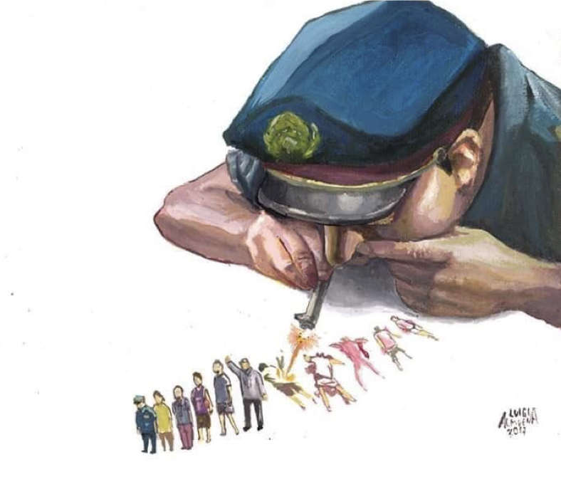
The Philippines:
War on drugs
War on the poor
War against democracy
War on human rights
War on health
Artist: Luigi Almuena

Slide 3
WHAT’S HAPPENING
20,606 killed: 4,251 from “legitimate” police operations, & 16,355 “deaths under investigation.”
98,799 anti-drug operations & 142,069 individuals arrested
1.3 million “drug users or drug pushers” who surrendered
Political attacks: Sen. De Lima in jail; Chief Justice unconstitutionally ousted; Vice-President vilified; spate of killings targeting local officials & priests; independent media attacked.
*With contributions from Kristine Mendoza

Slide 4
IMPACT ON HEALTH
The most explosive HIV epidemic: 54,332 total HIV cases since 1984; 79% of these cases were reported from 2013 to 2018.
Almost 80% of new cases among MSM, while 4% among PWID
National govt challenging health-based responses to drugs, including harm reduction
Public funding going to war on drugs is immense
Climate of suspicion vs civil society and communities

Slide 5
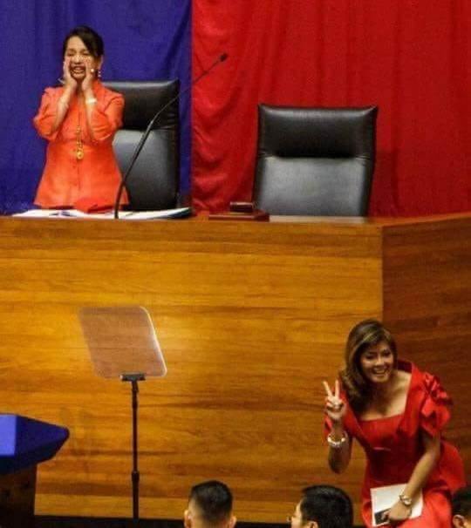
WHY IT’S HAPPENING
The Philippines as a weak democracy
War on drugs as Duterte’s formula to consolidate power & survive
War on drugs as a platform for impunity, in parallel to other social control campaigns (anti-loitering, anti-smoking) & effort to amend the constitution

Slide 6
Resisting Duterte
Ongoing human rights initiatives to document human rights violations, especially killings, and to support ICC case
Ongoing community-led efforts: delivery of ARVs for PLHIVs in detention; harm reduction services for PWIDs
Harm reduction advocacy: an NGO organising trainings on harm reduction for various stakeholders; a PWID community group delivering services; a group of young lawyers sensitising legal community for drug policy reforms and to deliver legal aid for people who use drugs; efforts to reach out to urban poor communities disproportionately affected by the war on drugs.

